Slide 1


Machine Learning to Predict Outcomes of NHL games
Martin Krizan
Data Analysis Apr ’24
Ironhack
Notes:
Hello to my data analyzing brothers, and my ux/ui and web developing cousins my name is Martin Krizan and welcome to my presentation on using Machine Learning to predict the outcome of NHL games.

Slide 2
OBJECTIVES
Gather sufficient in game data
Run models on the data
Pick the best/most appropriate model
Use that model to predict future matchups (playoffs)
Notes:
This is pretty self explanatory. These are the steps we need to go from having no data, to getting our predictions.

Slide 3
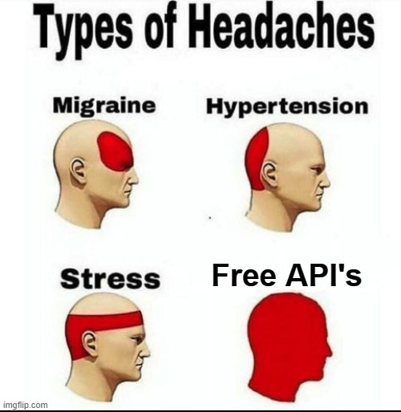
Gathering Data
Notes:
So step 1 is gathering our data. I was unable to find any CSVs or prepared files with the data that I needed, so my next best option was to use an API. I had to use a free API due to the difficulty in obtaining a paid one. The most challenging part about this was that I was limited to 1,000 calls, and if I exceeded it I had to create a new gmail account so that I could re-register. Also another thing to take into account with pulling data from API’s is that if it is done too frequently, you can be blocked. So common practice is to put a time.sleep function on there with random. To get mine to function properly without booting me I had to set it to an interval of 10 to 12 seconds.

Slide 4

Gathering Data
Getting Game IDs
Running Game IDs to Get Individual Game Stats
Notes:
Gathering my data to be able to create a dataframe was a 2 step process. First I had to pull the game IDs from games within the 22-23, and 23-24 seasons. Once I had this, the next step was to set up a function to go through each of these game IDs on the API to pull the individual stats from each game. Once we had this, I converted it into a dataframe and CSV to have our data to work with.

Slide 5

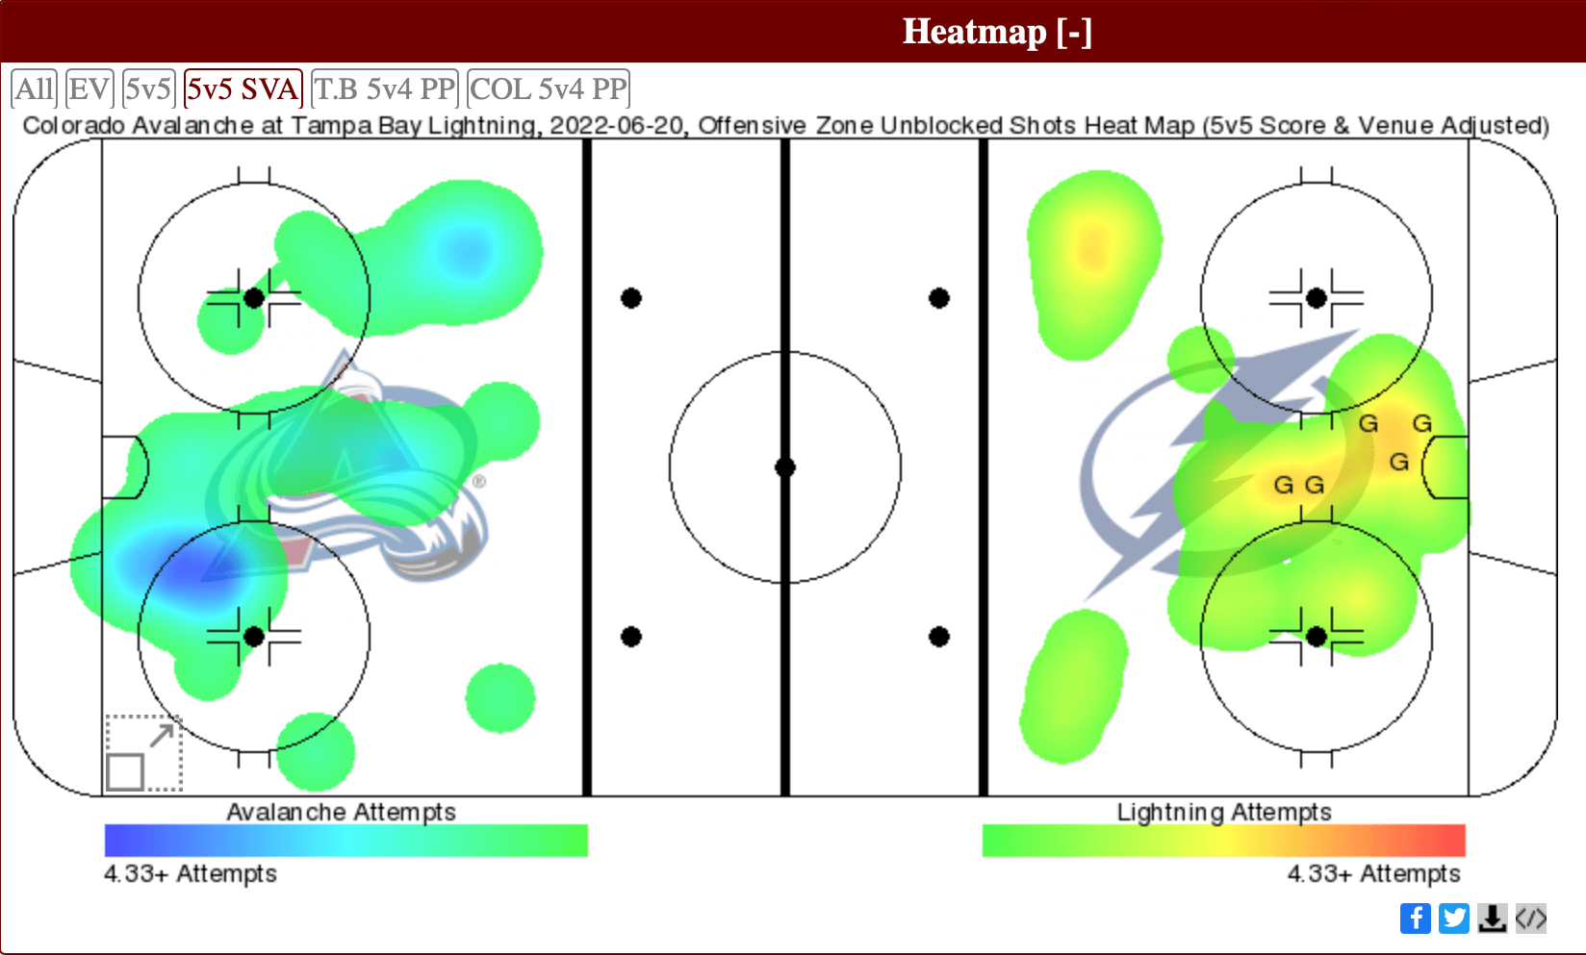
Selecting Features
Notes:
The next step was weeding out irrelevant information, cleaning, and then choosing the features for the models that would be most relevant in helping predictions. We took all pertinent in game stats everything from attendance to percentage of converstion, shot distance and much more, leaving out the game result as our target. Thus we trained our models.

Slide 6
Models
Linear Regression
KNN
Random Forest Classifier
Notes:
Linear regression models are statistical methods that establish a relationship between a dependent variable and one or more independent variables by fitting a linear equation to observed data. K-nearest neighbors (KNN) is a method used to determine the category of an item by looking at the types of items that are most similar to it. For instance, if you want to predict whether a fruit is an apple or an orange, KNN looks at the nearest fruits around it and majority of those fruits' types determine the prediction.
A random forest classifier builds a collection of decision trees, where each tree is created using a random subset of features and data points. When making predictions, each tree in the forest votes on the outcome, and the classification result is determined by the majority vote from all trees, enhancing accuracy and reliability.

Slide 7


Linear Regression
95%
Notes:
The linear nature of the model comes from the assumption that the relationship between the variables and the outcome of the game (win or loss) can be described by a straight line. Essentially, it posits that changes in these predictor variables will result in proportional and predictable changes in the outcome, allowing for a straightforward computation of the likelihood of winning or losing based on the linear combination of these input variables.

Slide 8
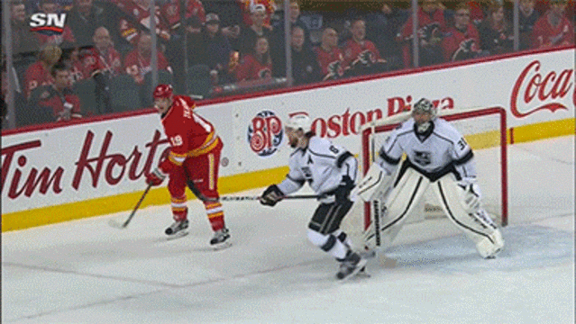
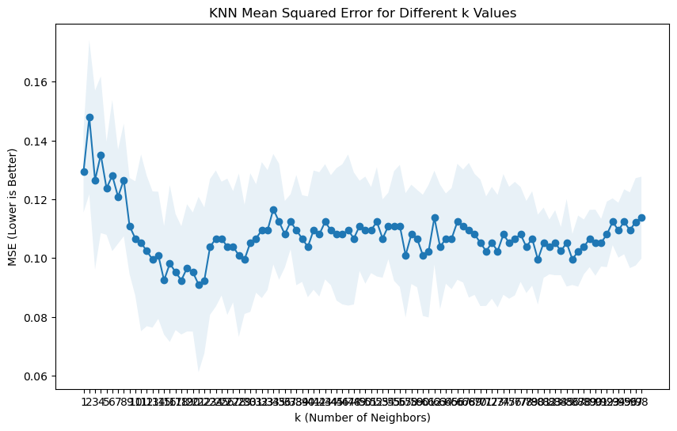
KNN
89%
N=22
Notes:
KNN might perform less effectively than linear regression in predicting the outcome of a hockey game because it relies on the local similarity of data points, which can be problematic in sports contexts where factors influencing outcomes might have more complex relationships and variations. For instance, the game dynamics in hockey, such as team strategies or player forms, might not be well-captured simply through the nearest neighbors approach. Still, it is not performing terribly here.

Slide 9

Random Forest Classifier
96.5%
Notes:
Random forest might perform well in predicting hockey game outcomes because it can handle the complexity and interactions among various game-related variables—like player statistics, team form, and historical matchups—without being overly influenced by outliers or noise in the data. Additionally, its ensemble approach, where multiple decision trees vote on the outcome, helps in capturing diverse patterns and anomalies, leading to more robust and accurate predictions across different game scenarios.

Slide 10
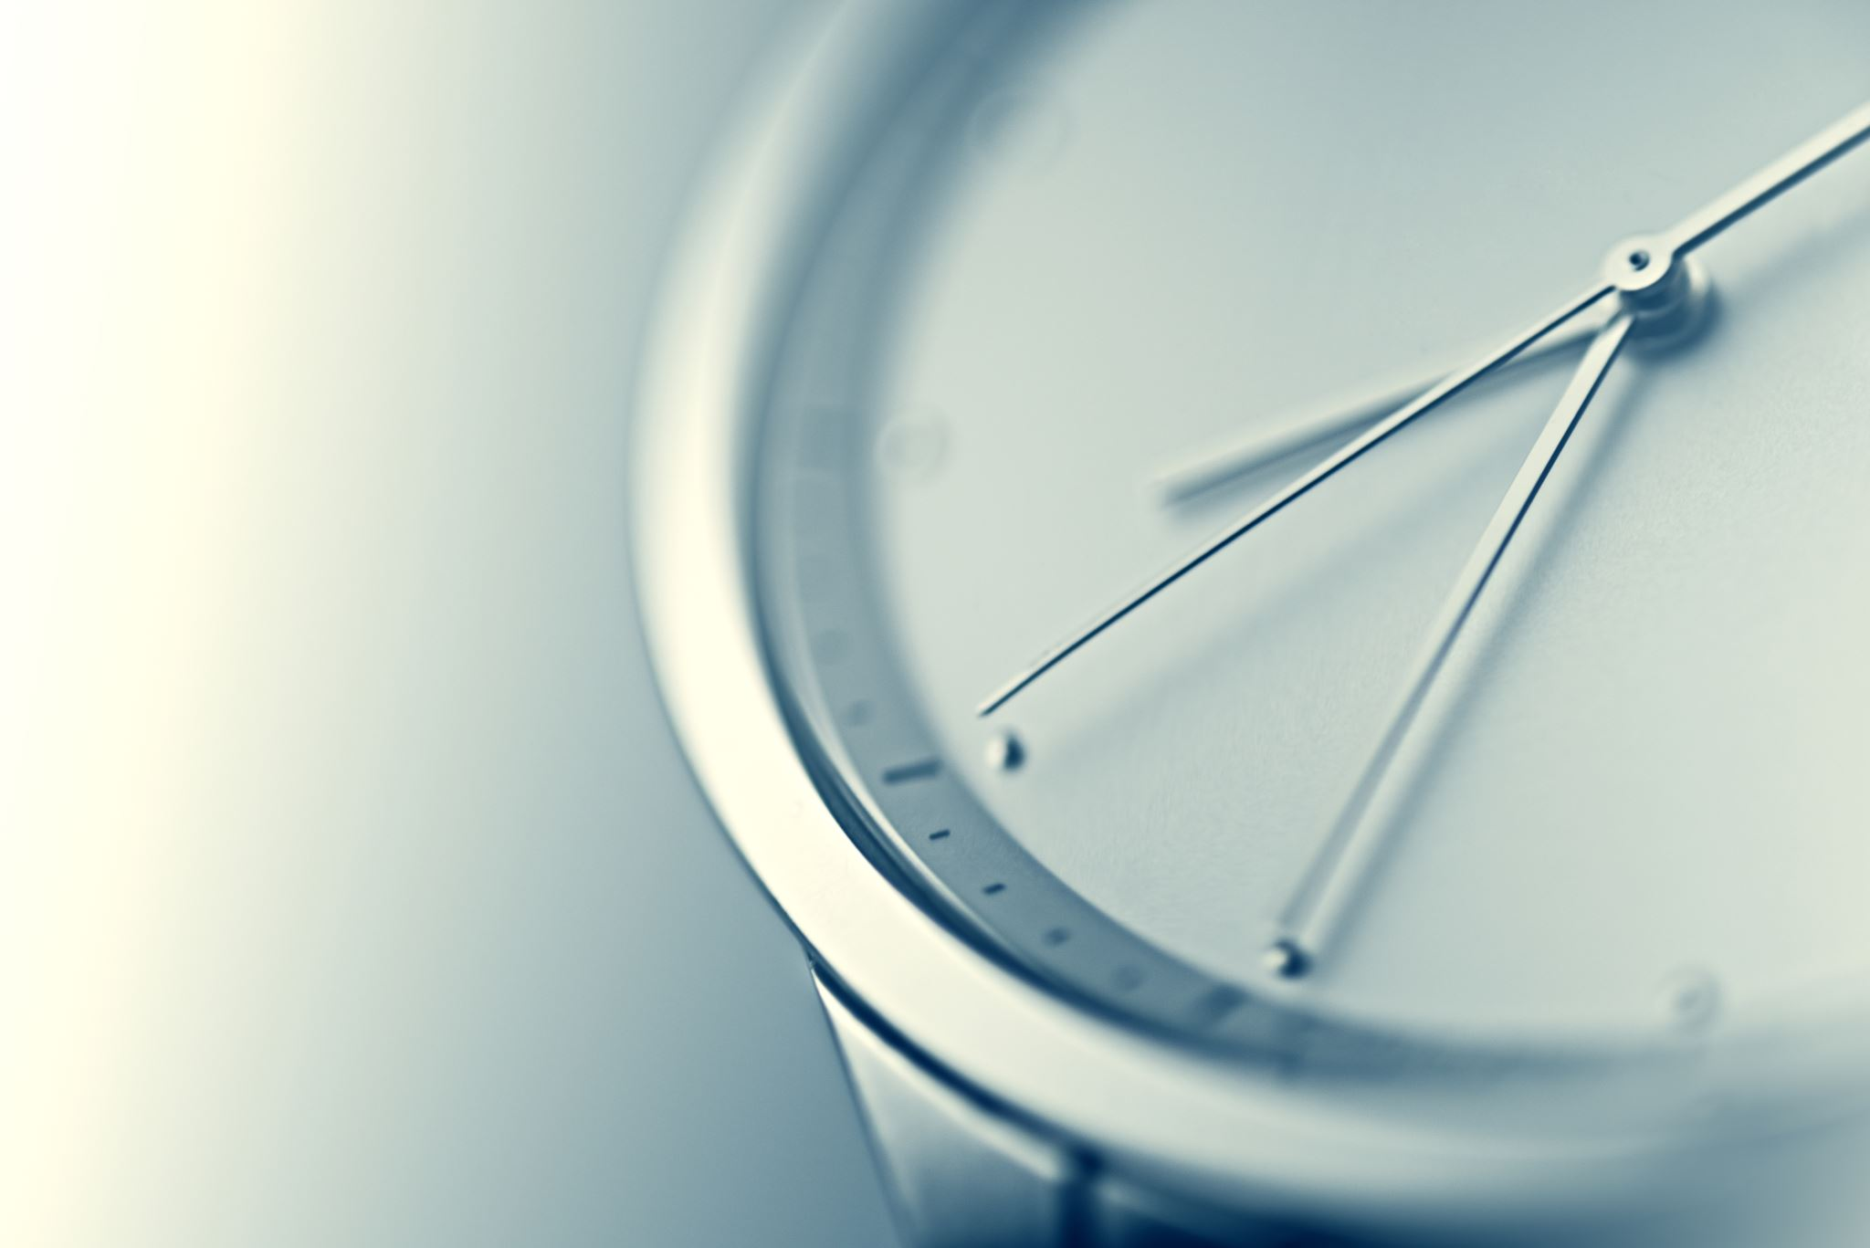
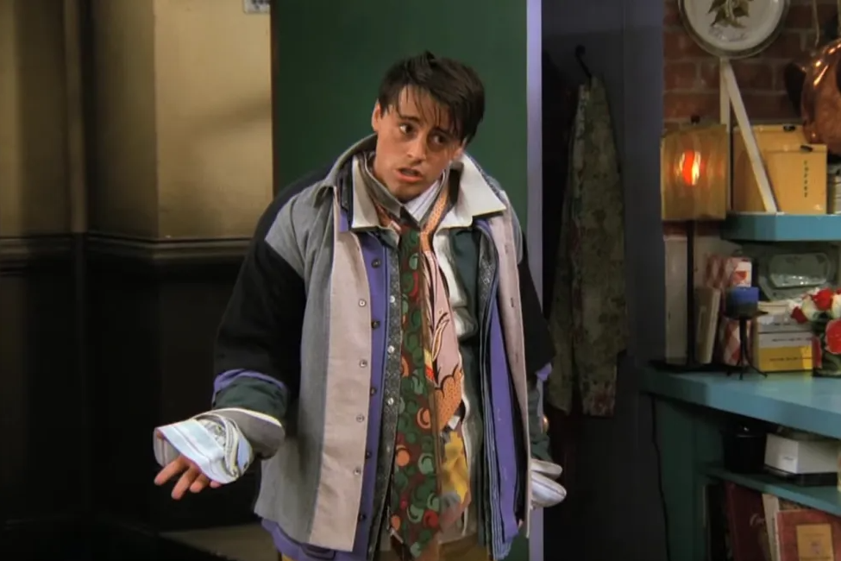
Checking for Overfitting
Notes:
Checking for overfitting is crucial because it ensures that our model doesn't just memorize the training data but generalizes well to new, unseen data. We determined that our model is not overfitting by comparing its performance on both the training and testing datasets; if the model performs well on both, it indicates that it has learned the underlying patterns in the data without simply memorizing it.

Slide 11
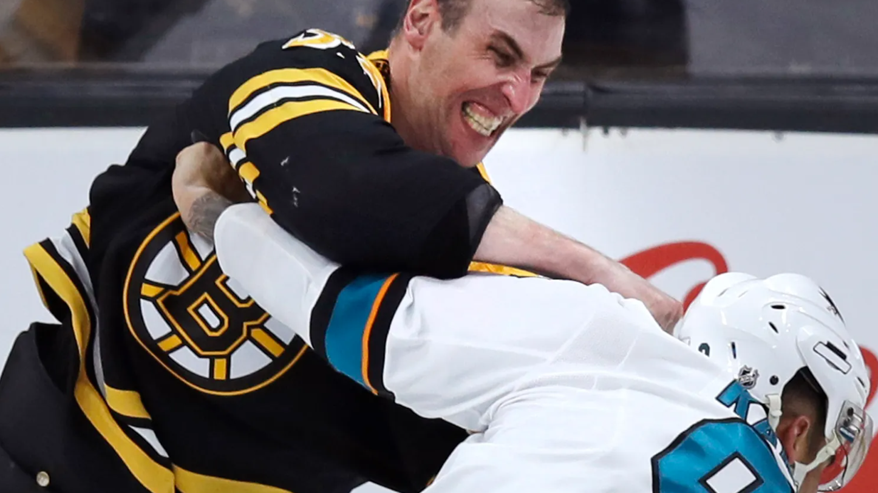
Linear Regression VS Random Forest
Notes:
Interpretability is crucial because it provide clear insights into the relationship between the independent variables and the target variable. With linear regression, it's easy to understand how each feature contributes to the prediction, as the coefficients directly indicate the magnitude and direction of the effect. While the Random Forest Classifier was slightly better in accuracy score, it is better suited to explaining complex relationships in the data, but since the analytical data is not too convoluted, and in fact, visibly interpretable, the Linear Regression model becomes my choice (although it was a close race).

Slide 12
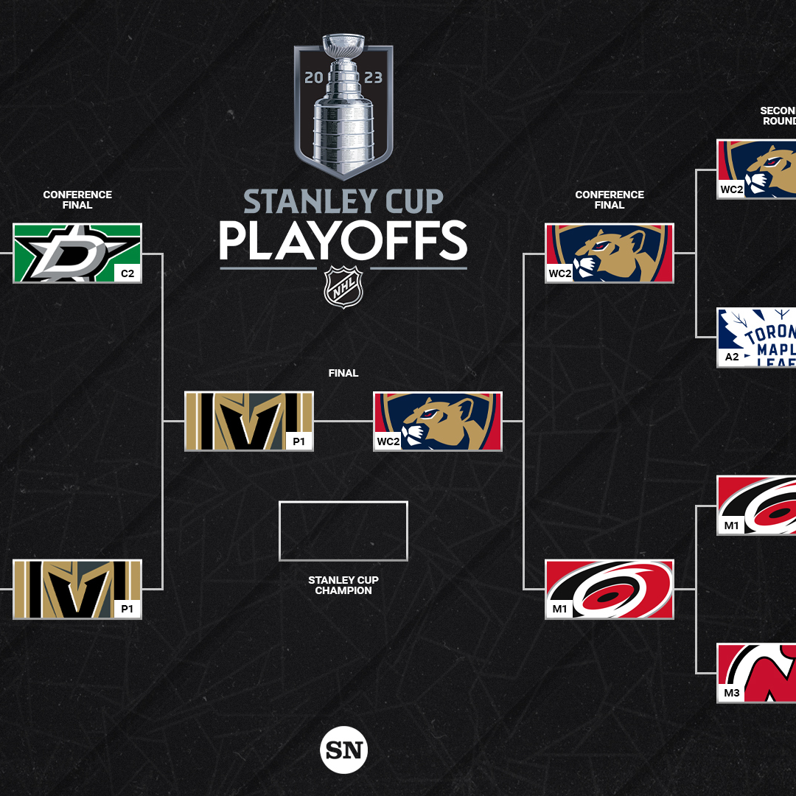
Step 2
Importing the model
Adding the team names back into the data to ID them
Calculating the average statistics for each team to represent their aggregated performance
Running the teams against each other in playoff scenarios to get a playoff prediction

Slide 13
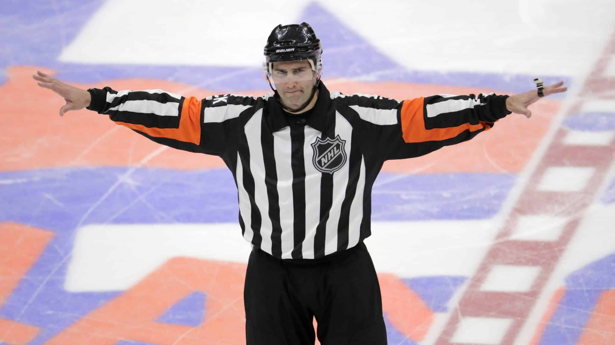
Challenges
Notes:
Free API challenges aside, the first half ran very smoothly. The issue started arising in the second part of the project. After properly setting up the logic for functions to 1. Predict a single game winner with the model 2. to Predict an entire best of 7 games round, and finally 3. running an entire best of 16 tournament through those functions, I ran across a multi-layered problem. The home and away teams were not running properly in the functions because they had an uneven number of features, as I tried to have it set up to take into account who was home and who was away, because the original data was mostly from the home team of each game, so the data was skewed towards that, leaving an imbalance. After doing a lot of troubleshooting I was able to get the number of features to match up, but then it was giving me an erroneous prediction of the away team winning every game in every scenario for the playoff round. By this point I ran out of time.

Slide 14
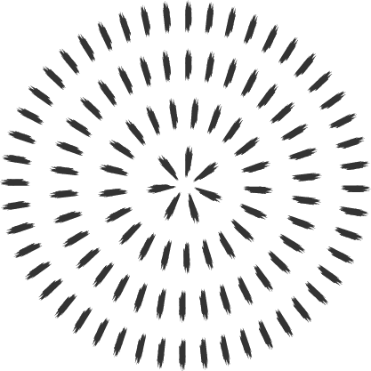
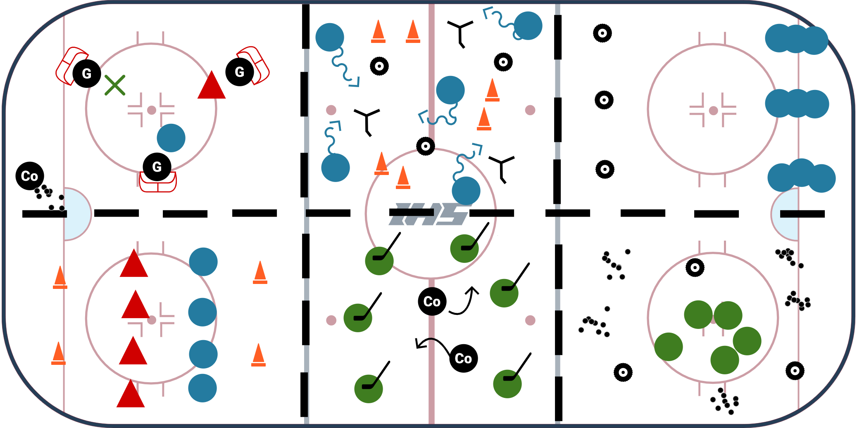
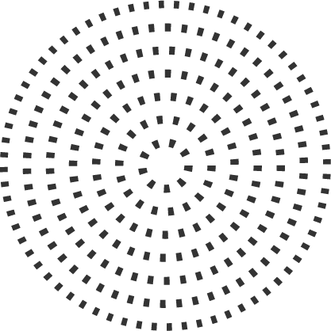
What I would do now
Notes:
My biggest oversight was to try and break the features from each game to suit the home and away teams, which resulted in the aforementioned imbalance. Therefore the proper solution would be to use the entire analytics from each game applied to only the home team. This is because since we are taking the average of all the results, we are also taking the average of the stats against them (which we can also interpret as how well (or not) the home team defended, as opposed to how well the away team attacked). Taking the data like this will eliminate any issues of variable imbalance or inconsistencies, and it will allow the predictor to run in the same way that the model was originally predicting.

Slide 15

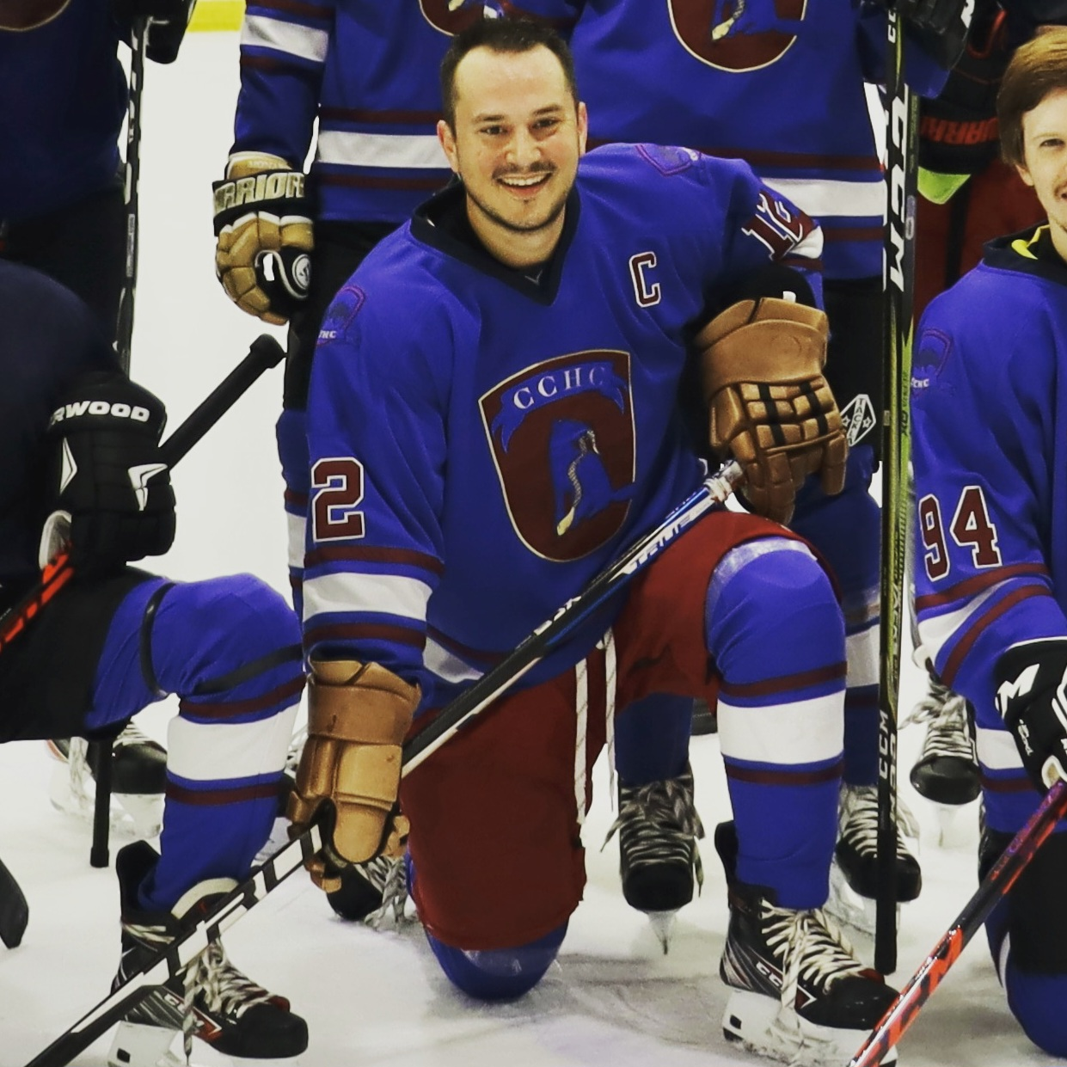
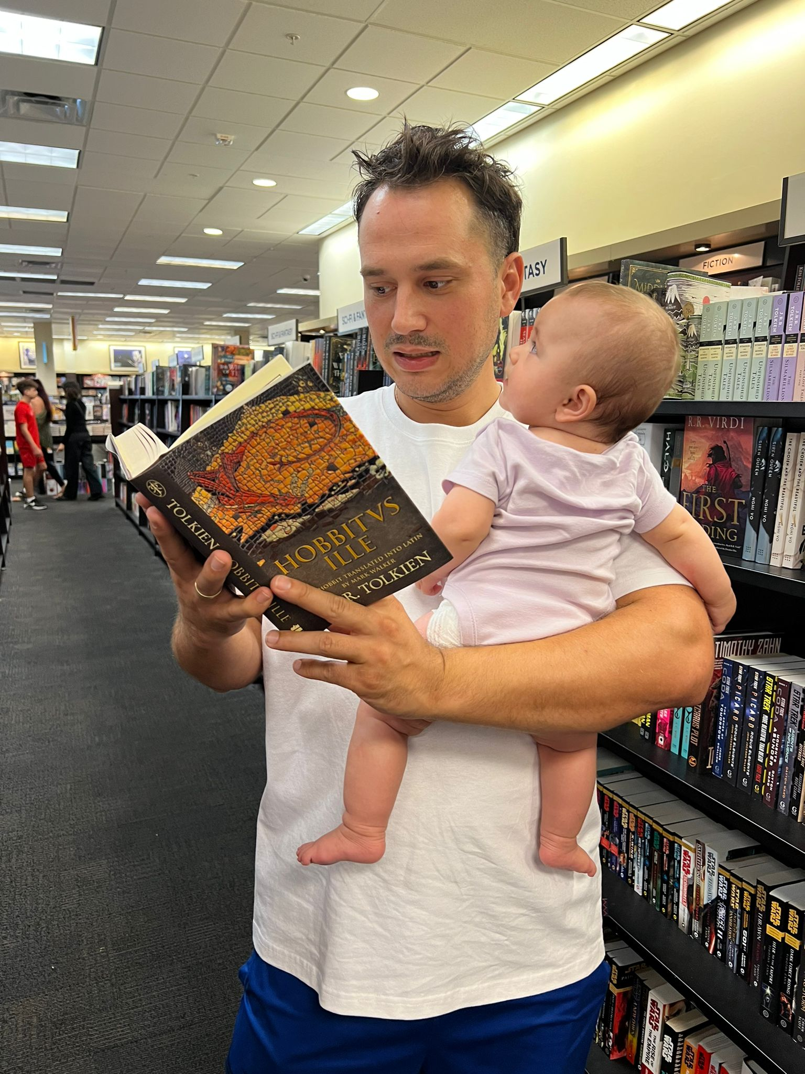
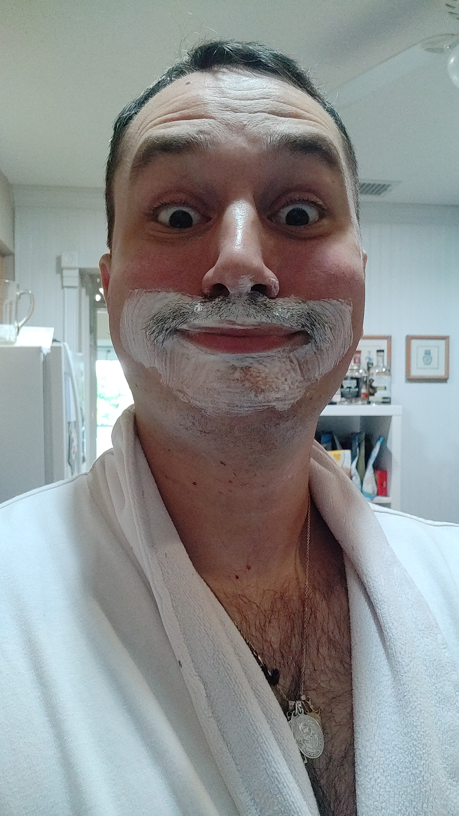
The Team
Martin Krizan Data Analyst
Marty Krizany Hockey Enthusiast
Martinius Krizanius
Data Spelunker
Morton Krozon
API Abuser
Notes:
Our lovely team, with our lead analyst, our hockey enthusiast for business acumen, our data spelunker who deep dives into the caves of logic (to figure out what the heck is going awry), and our resident API abuser, a maniac that hates sleep.

Slide 16

Thanks!

